Slide 1
Slaying a Life Optimizing GPU-accelerated Game of Life Stencil
🙋‍♂️ Matyáš Brabec
👤 Jiří Klepl
👤 Martin Kruliš

Slide 2
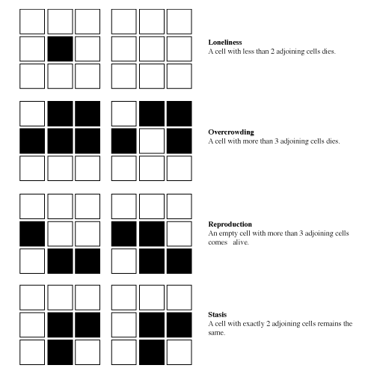
Game of life 👀
Grid
2 dimension
Cell states: DEAD ⚰️/ ALIVE 👶
Lonely
Crowded
Survives
Reproduction

Slide 3
Stencils
Iterative grid-based computation #️⃣
Each cell updated from neighbors
Algorithm (kernel) fixed for each cell
Examples 🧪
Simulations (atmosphere …)
Image processing (blur …)
Cellular automata
…

Slide 4
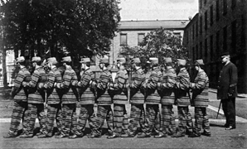
Challenges on GPU ⚠️
High memory bandwidth use
Instructions per byte ⚖️📉
Memory-bound performance 🐌
Code divergence 🔀
“if”s in the code
Stable regions 🧘
Unnecessary computation 💤❌
Unnecessary cache eviction 🧹💾
Individual threads
Warp

Slide 5
game of life rules
c ~ Current state of the cell
n ~ Number of neighbours
( )
c == 1
&&
n == 2
||
n == 3
||
c == 0
&&
n == 3
( )

Slide 6
game of life rules
= 1
n
( c | n )
000
001
010
011
*1**
001
001
011
011
1*1
n == 3 || ( c == 1 && n == 2 )
0011
0011
0001
0001
0001
0010
0010
Next state
is alive
|
|
0011
0011
( c | n )
→ == 3

Slide 7
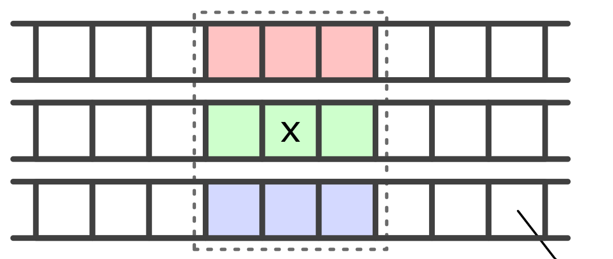
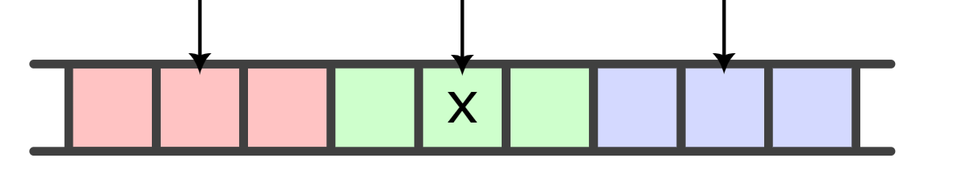
Dense memory layout (bit-packing)
Linear
64/32-bit word ~ ROW
Tiled
64/32-bit word ~ TILE
popc( )
…
popc( )
…
…
…

Slide 8
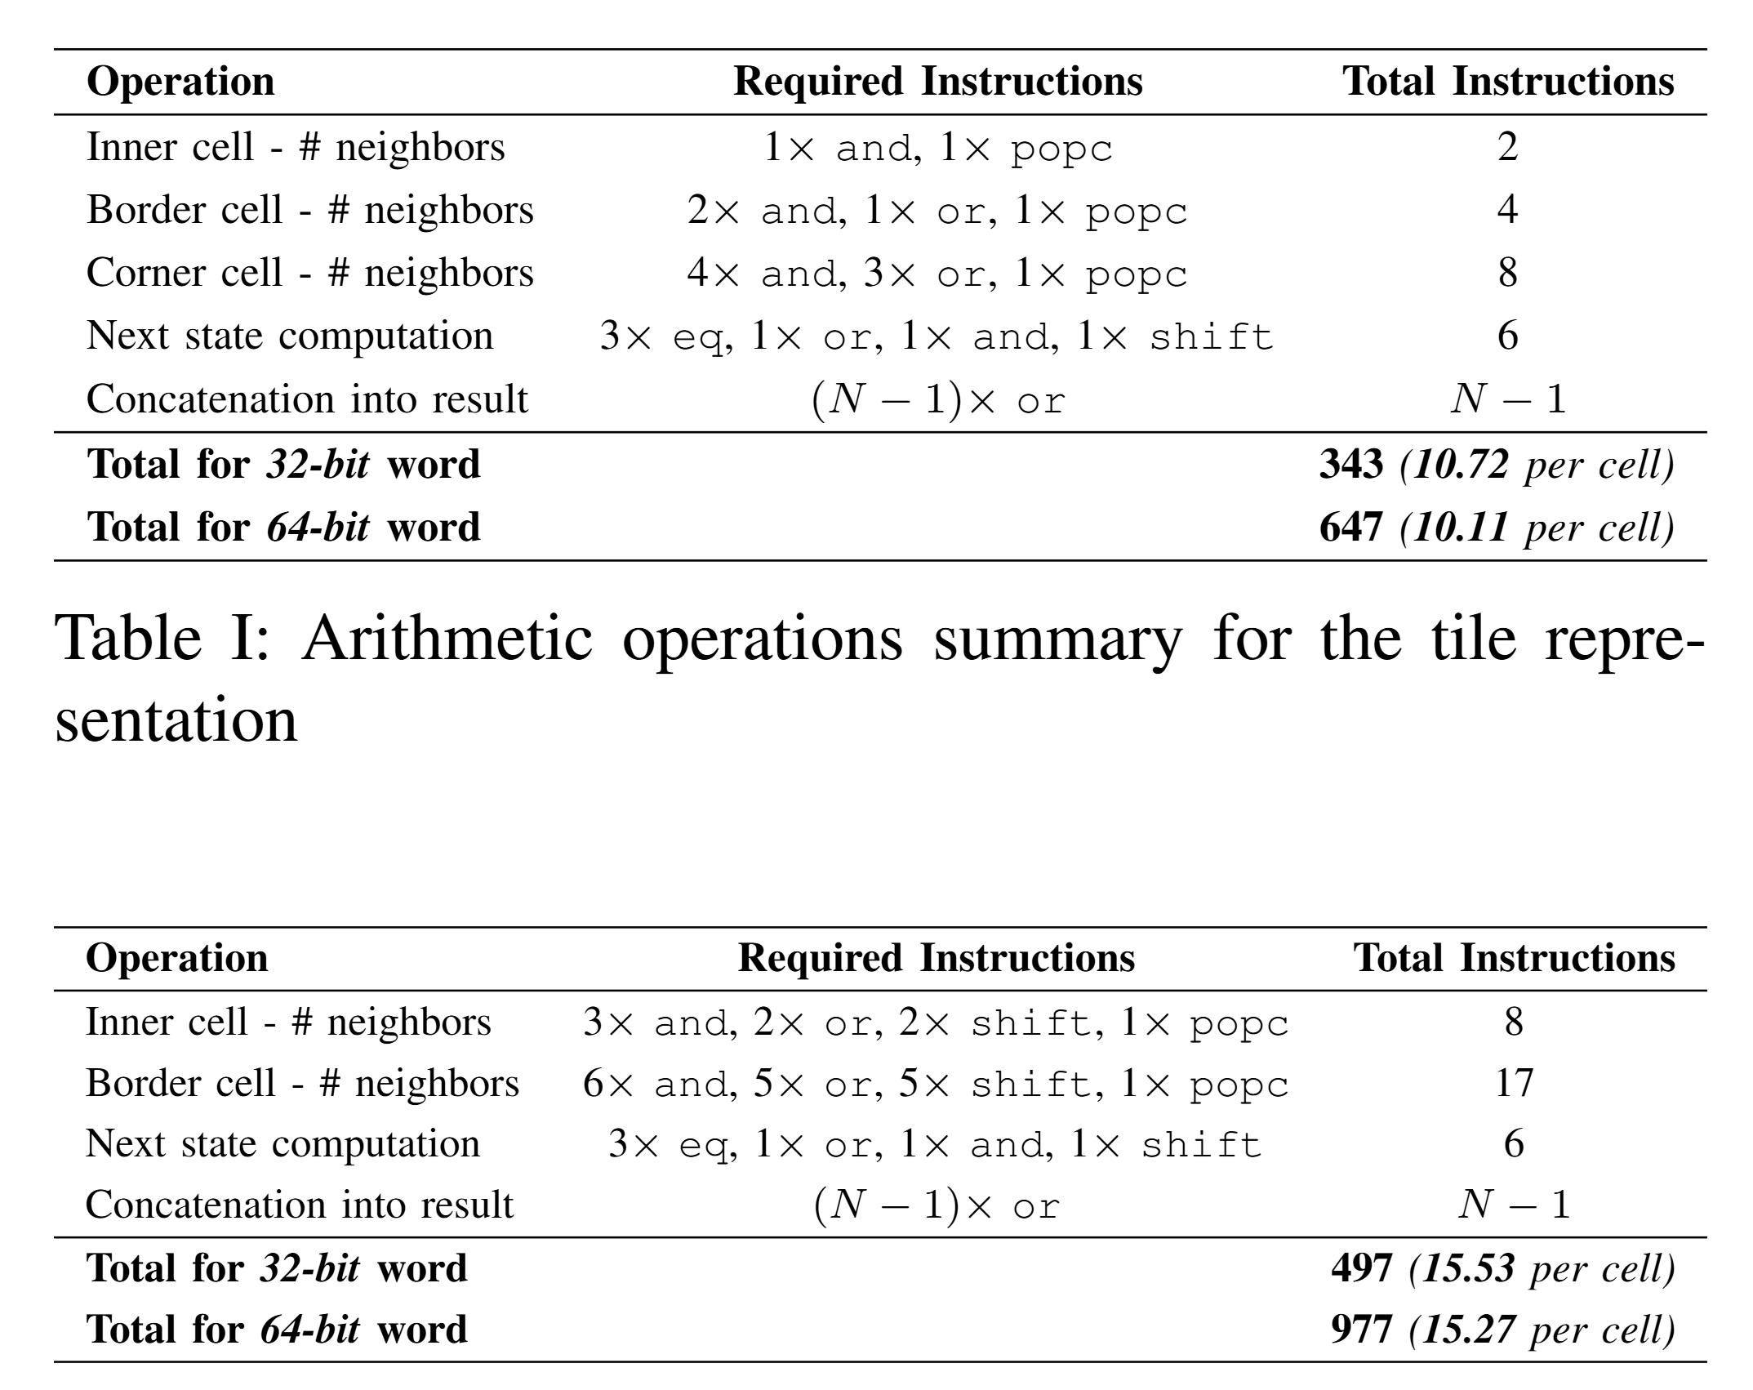
Ops per Cell 🧮
Linear 🐌
Tiled 🚀
~15 operations per cell
~10 operations per cell

Slide 9
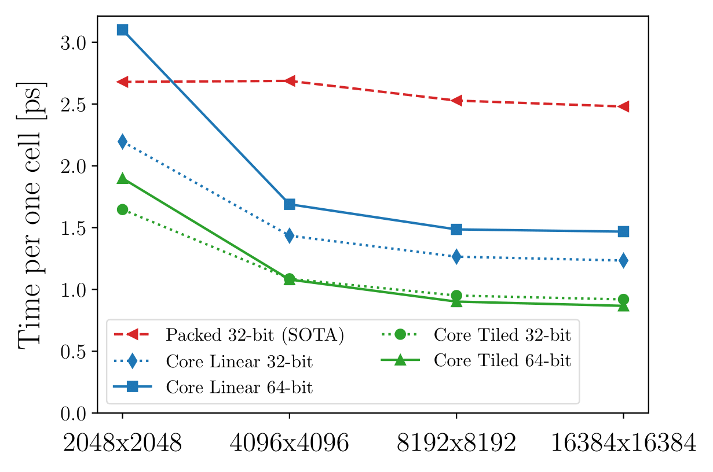
Resutls 📊
Baseline
Linear (32 b)
Time per one cell
Tiled (64 b)
Grid size

Slide 10

Work reduction 💤
💡Skip stable areas
❓what are “areas”
❓how to keep track of them
❓can we skip them
Demo: https://erunno.github.io/gol-work-reduction/

Slide 11
Work reduction 💤 (on GPU)
Grid tile per thread block
🔄 “Changed” data structure
One bit per warp tile
One 32-bit word per tile
…
…
little tile per warp
…
warp tile 💤
warp tile 💤
…

Slide 12
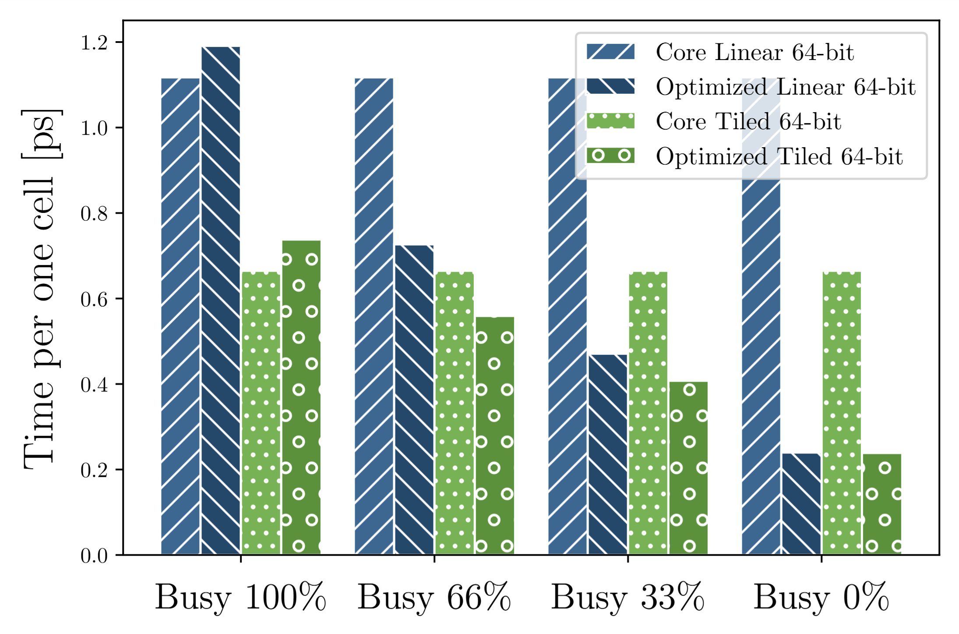
Results 📊
Linear
Tiled

Slide 13
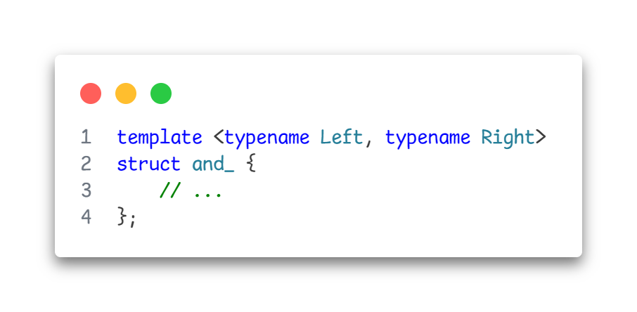
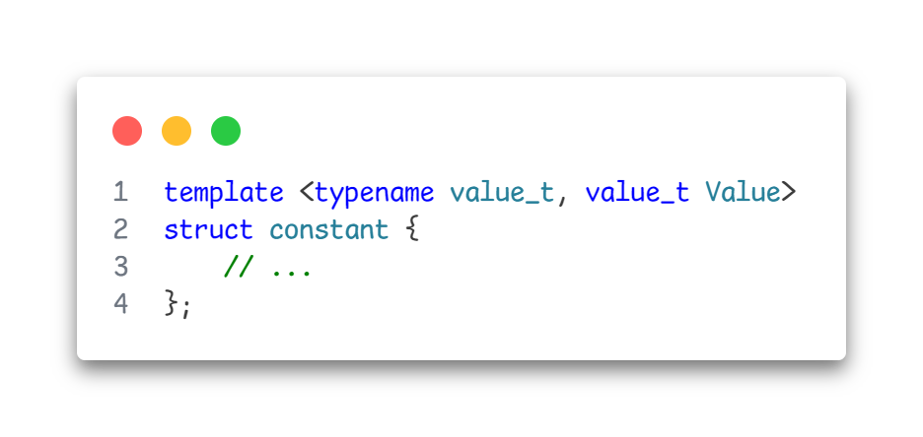
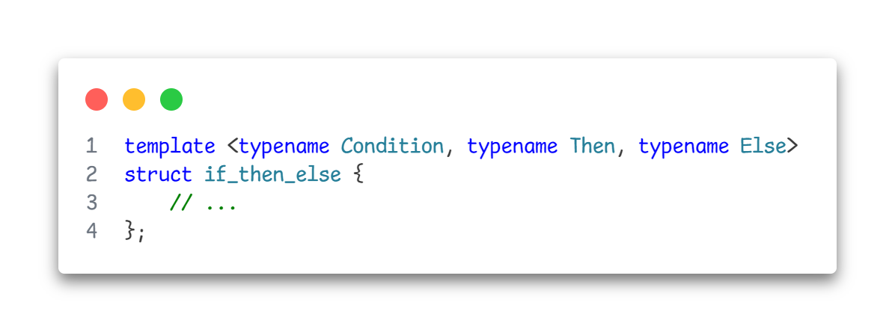
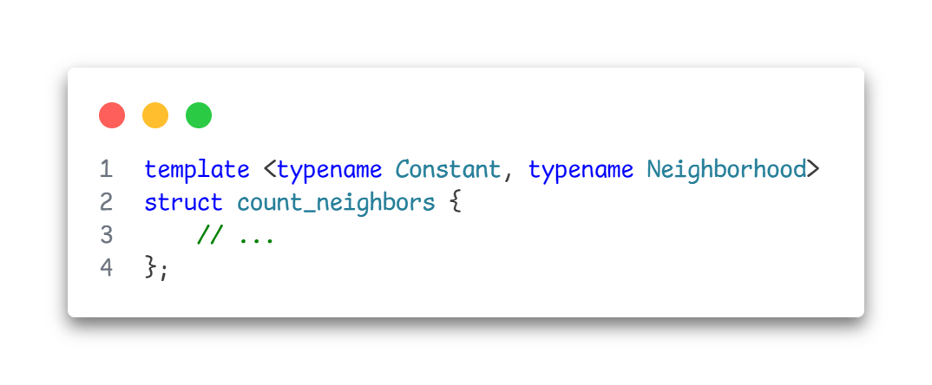
… Future work 🤔 (…or cry for help)

Slide 14
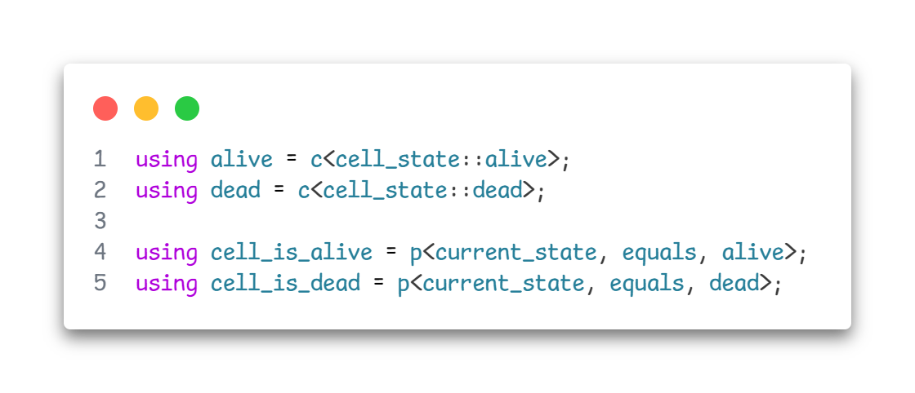
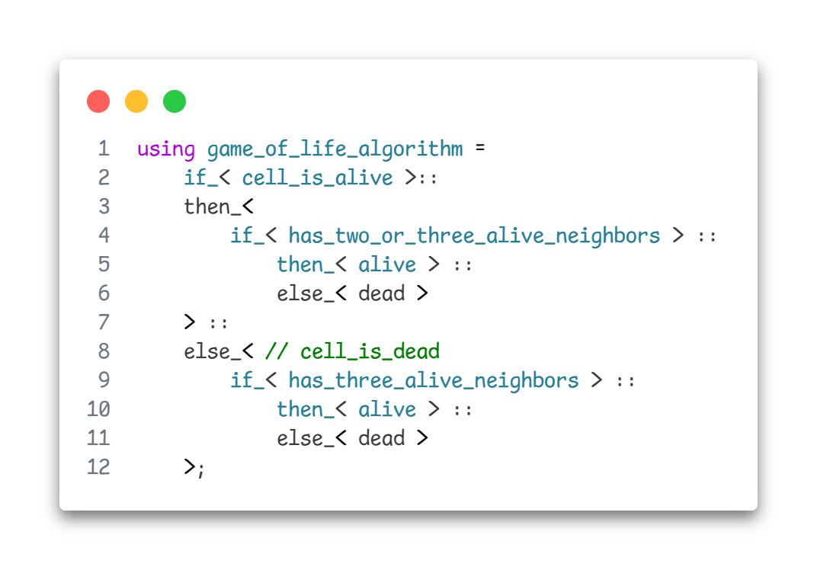
How is it used? 👨‍💻

Slide 15
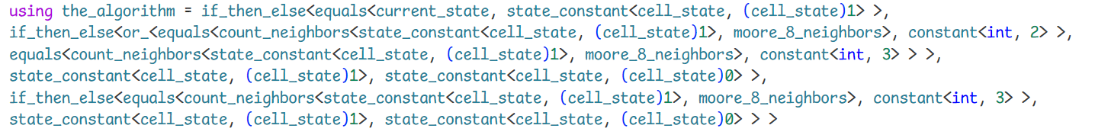
The algorithm is a type

Slide 16
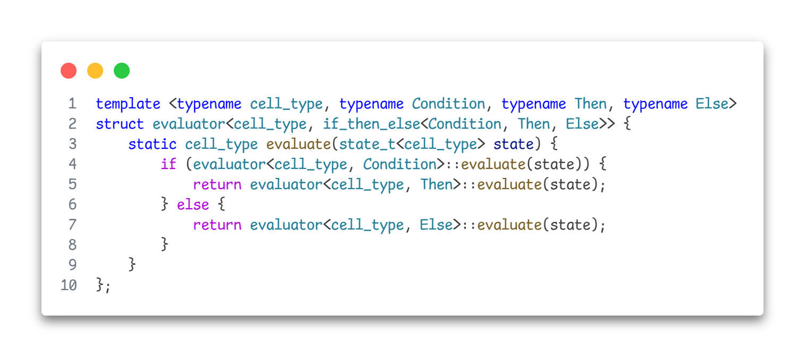
Evaluation

Slide 17
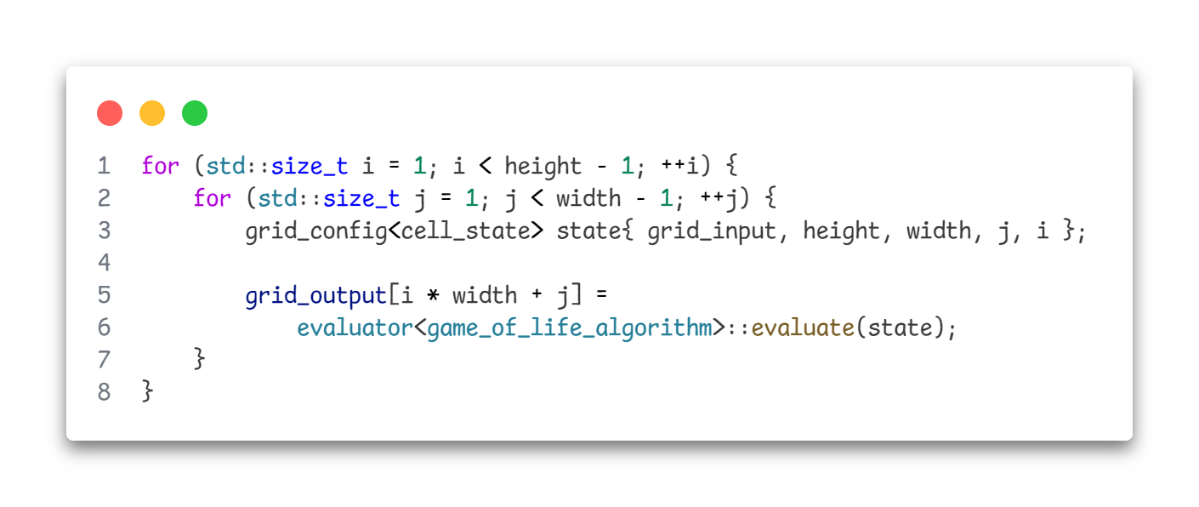
Evaluation

Slide 18
Nice … but why?
Game of life → 2 states → 1 bit
Forest fire → 4 states → 2 bits
Bit-packed memory layout
What memory layout should be used ???
1st bits
0th bits

Slide 19
The end

Slide 20
Obsolete 😢

Slide 21
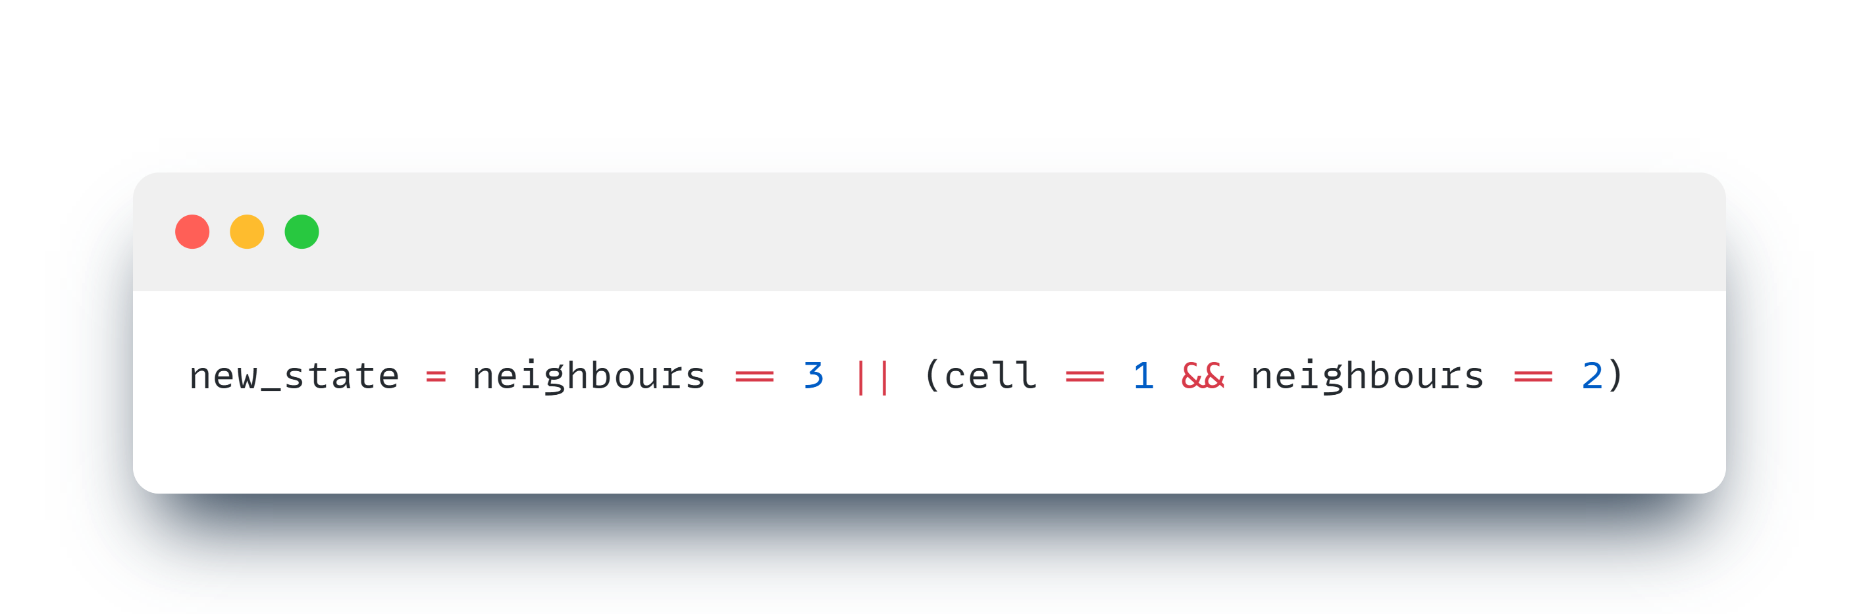
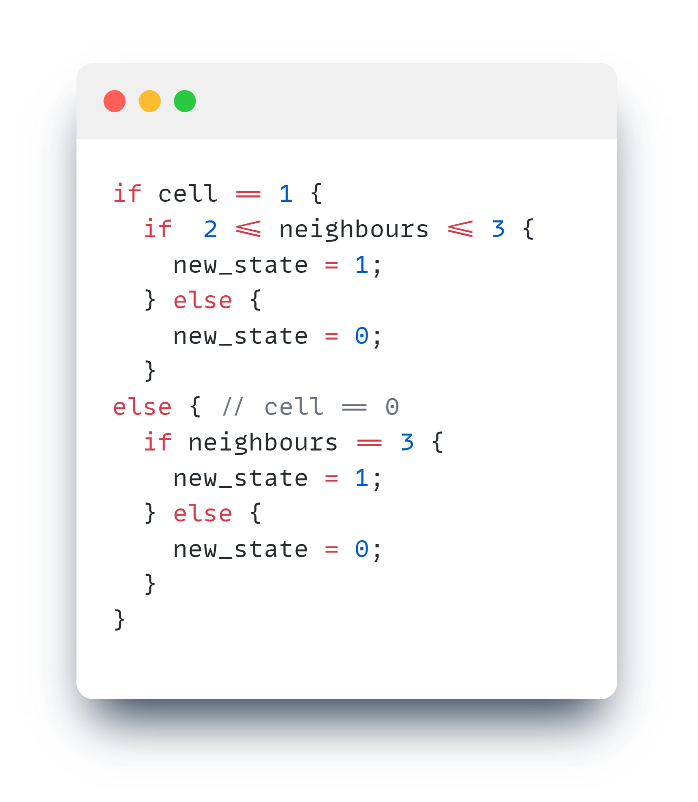
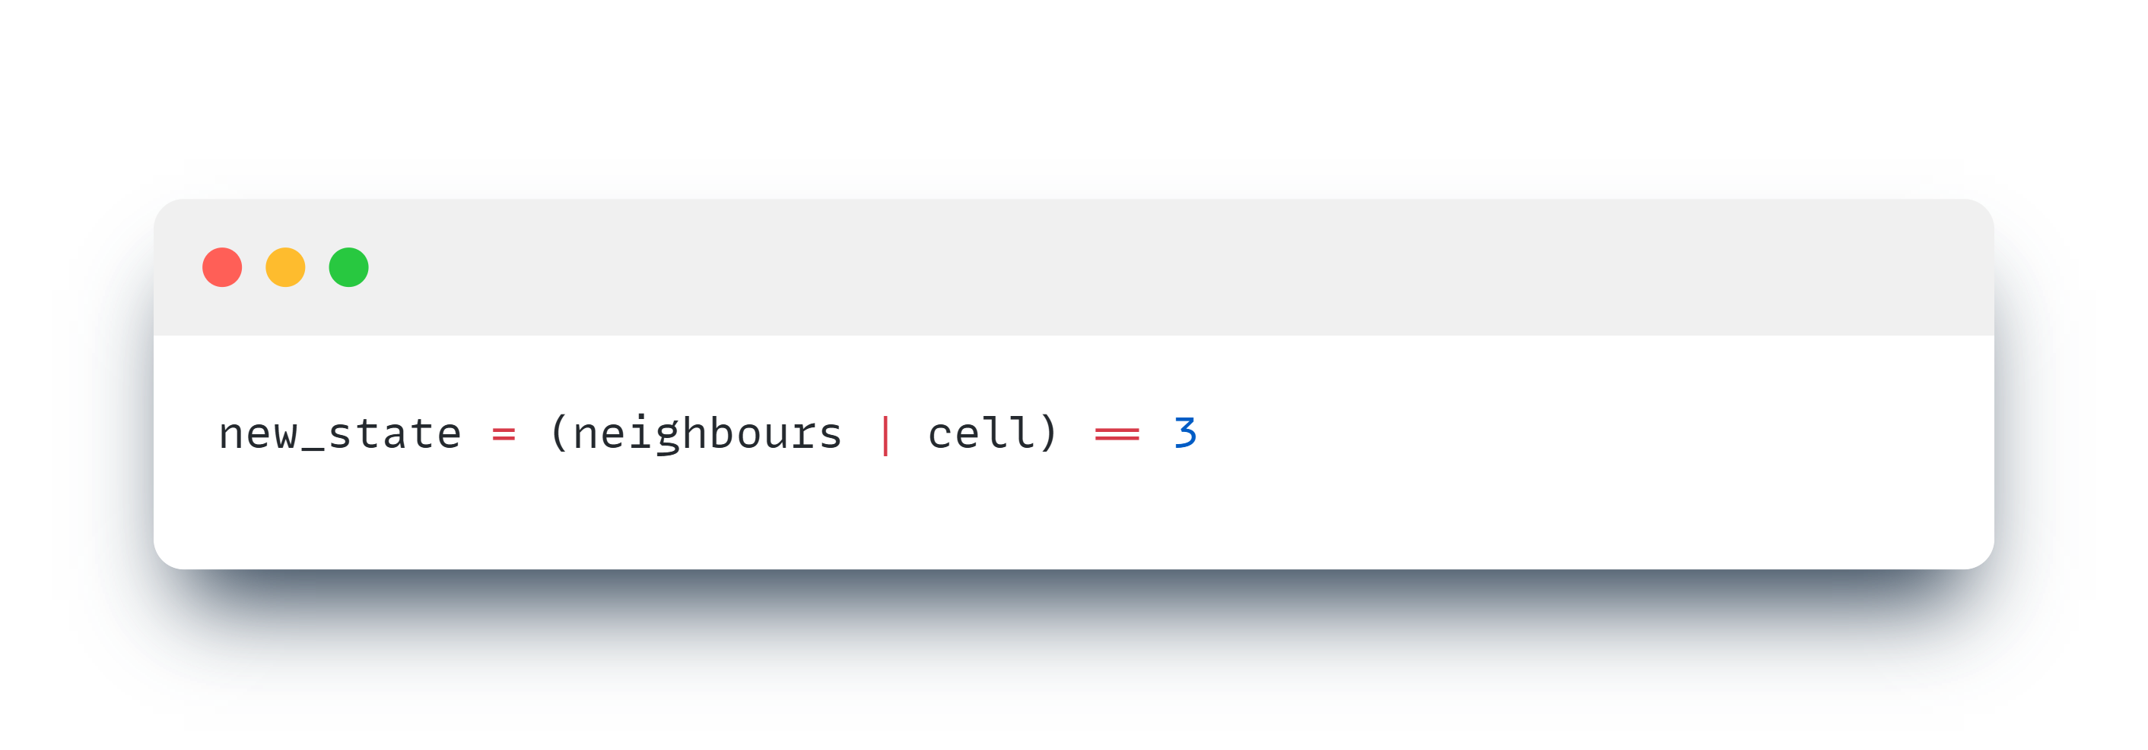
Rewrite game of life rules
🥹
😞
😞
😎 🚀
😞

Slide 22
Overview 🧭
Foundation 🧱
Game of Life introduction 🧬
GPU introduction 🖥️
Techniques proposed in the paper 🚀
Memory layout
Unnecessary work elimination
Following work 🧠
Better operations per cell ratio
Temporal blocking
Custom cellular automata language (within C++ templates)
DAG optimalization
Stencils #️⃣

Slide 23
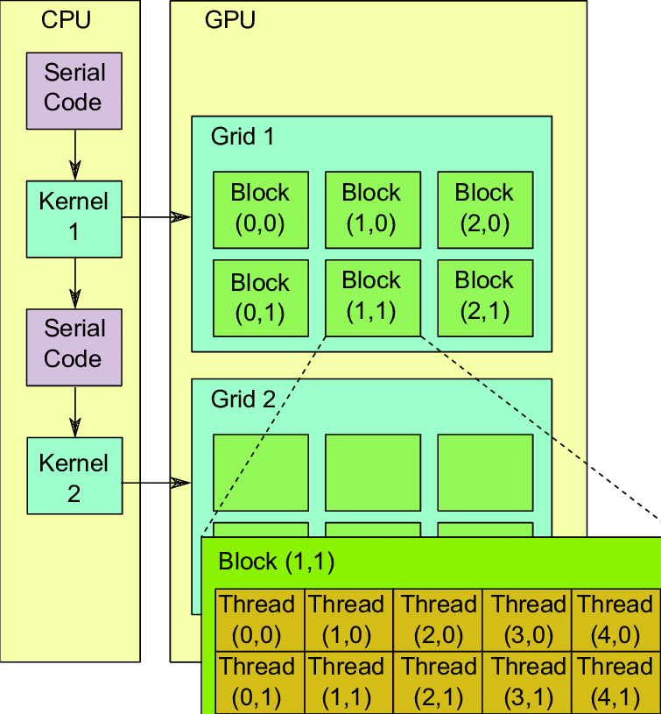
GPUs⚙️
Thousands of lightweight cores
🧠 1 Algorithm 📊 Different data
GPU hierarchy

Slide 24
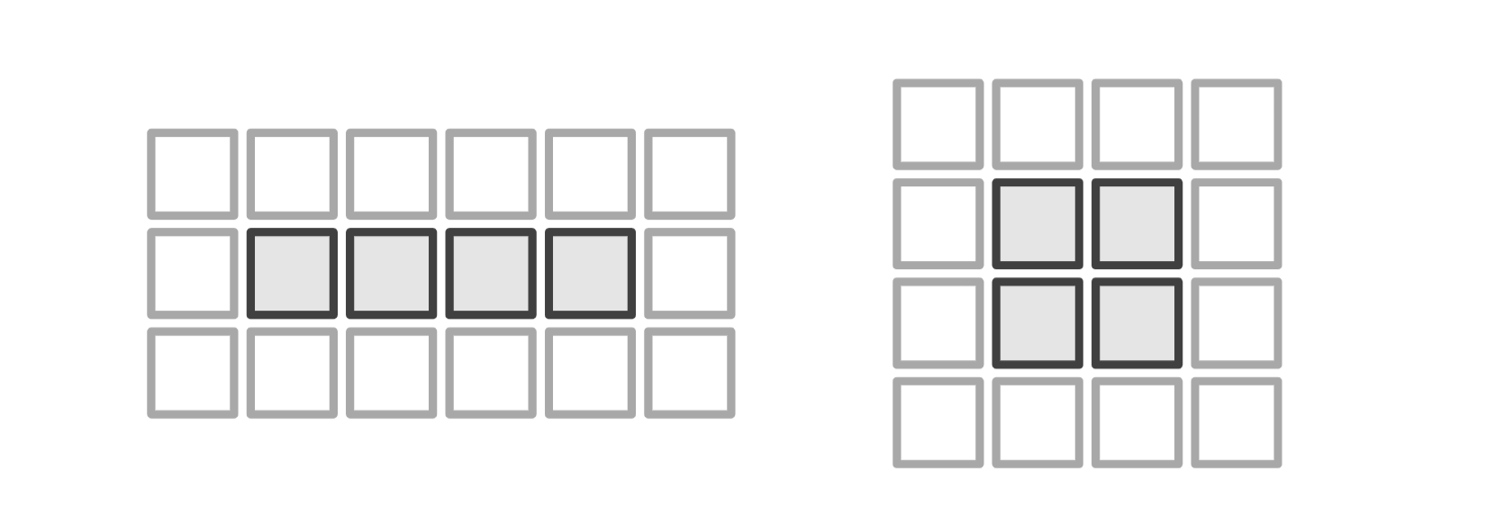
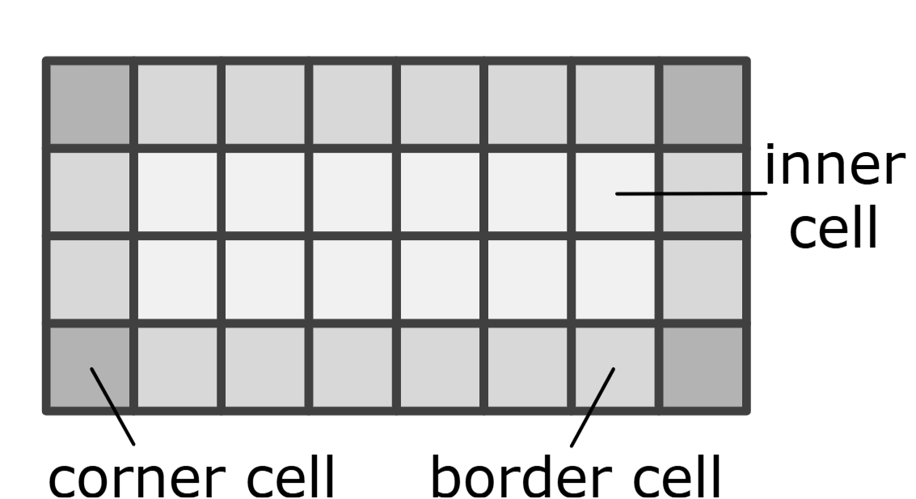
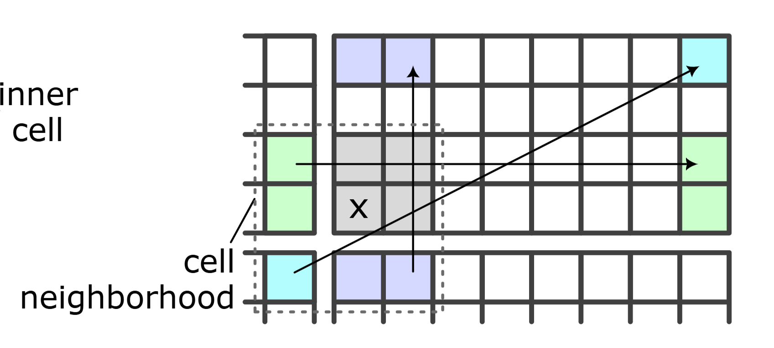
Dense memory layout (bit-packing)
Linear
64/32-bit word ~ ROW
Next state:
Tiled
64/32-bit word ~ TILE
popc( )

Slide 25
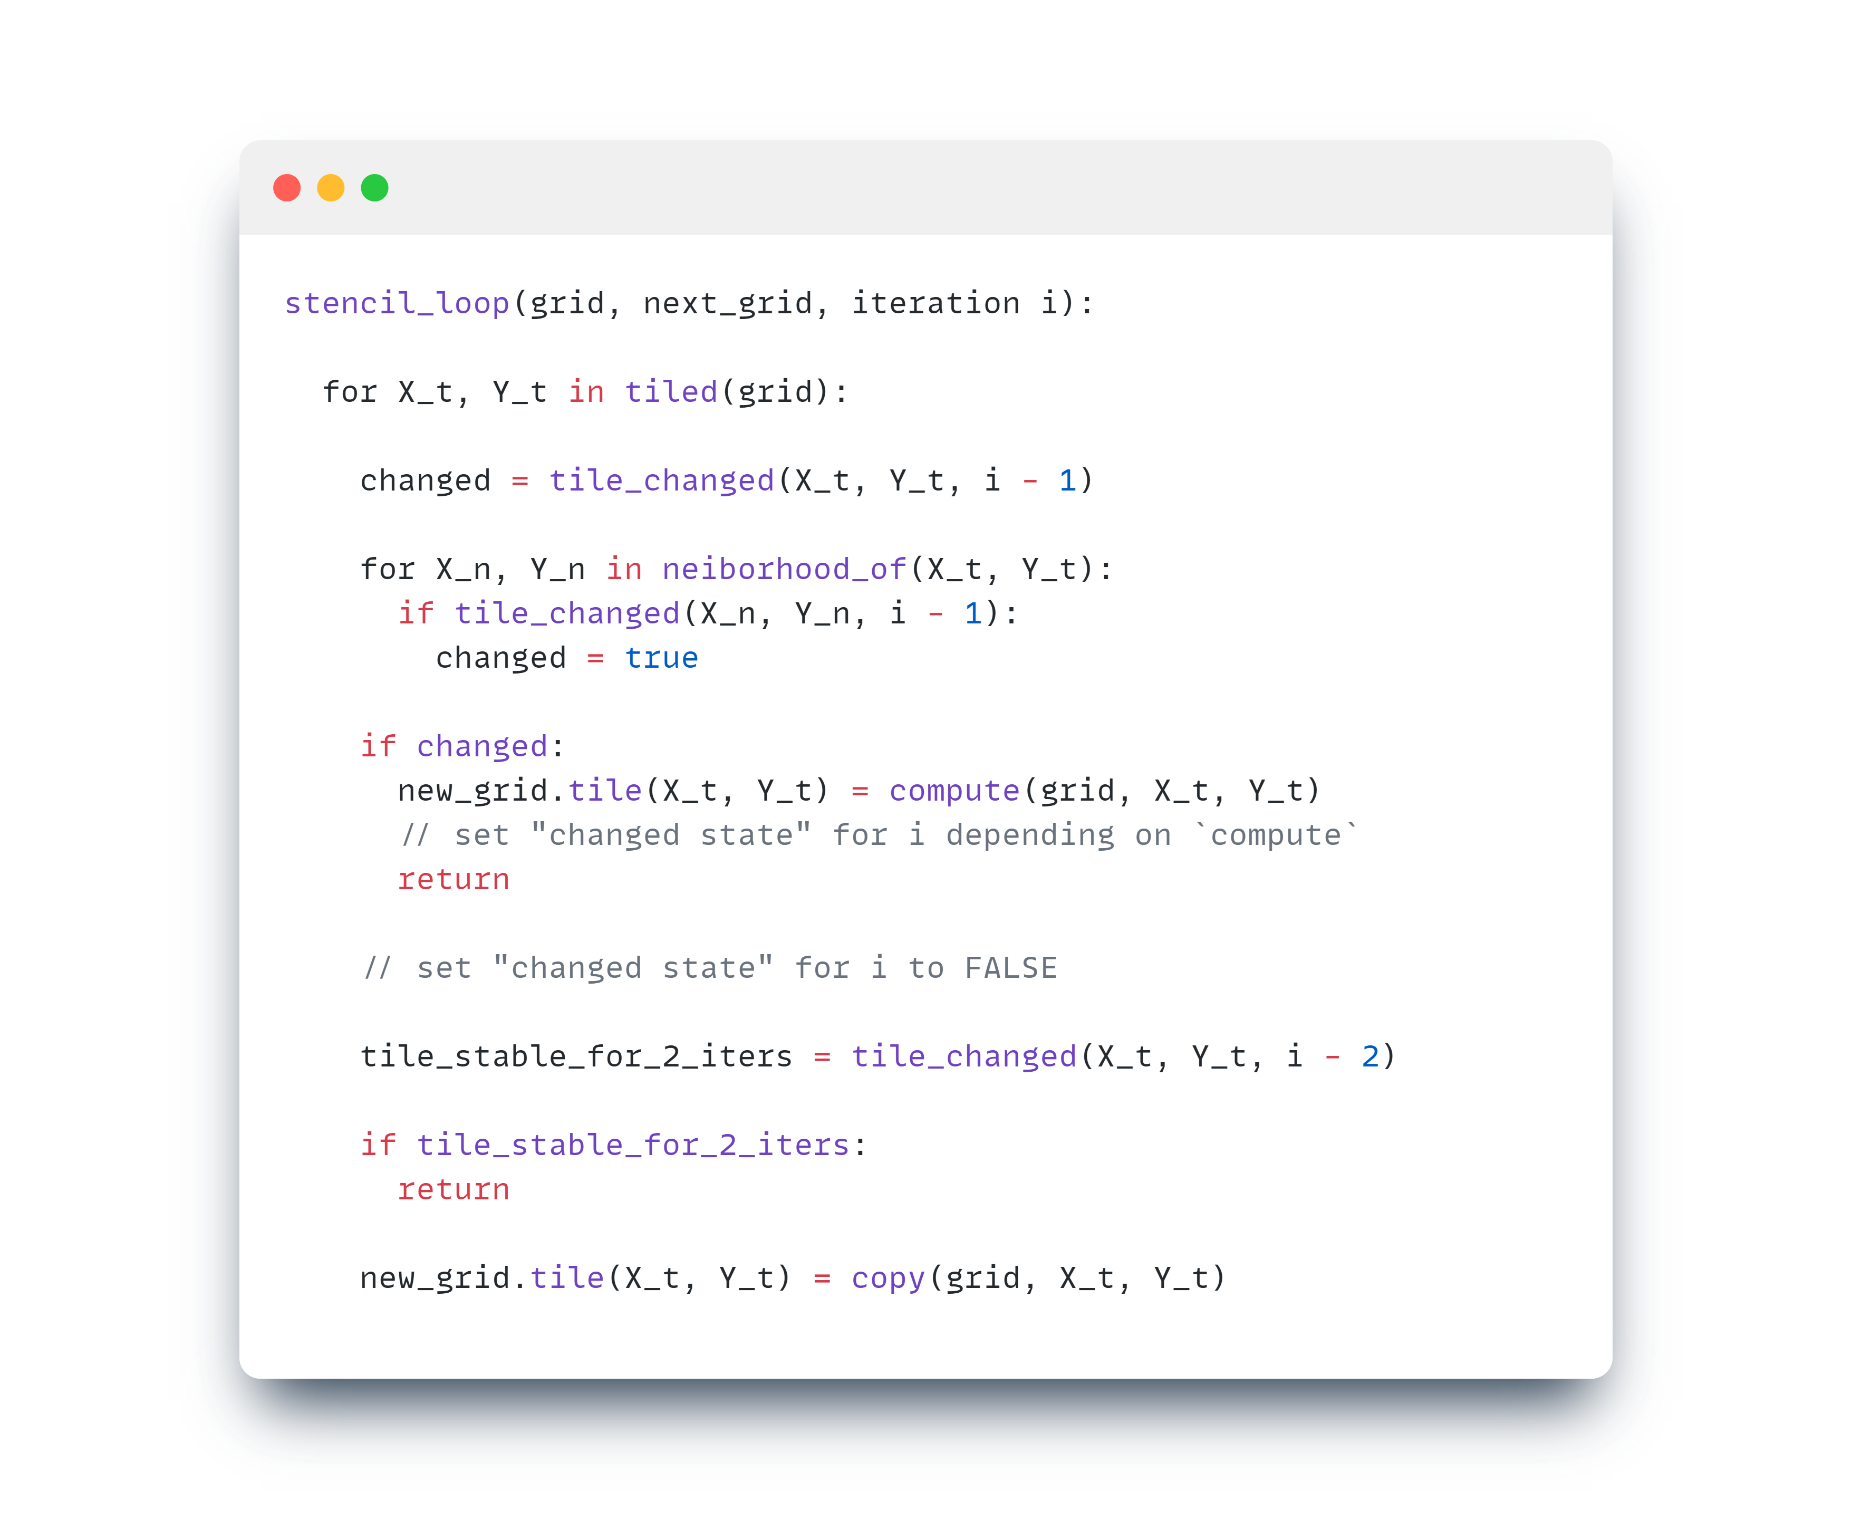
Better Algorithm 🧠🧠
Memory footprint 💾
Game of Life Grid
⏮️ previous
next
2 buffers
“Changed state” data structure
⏮️⏮️ (i - 2)-th
⏮️ (i - 1)-th
next (i.e. i-th)
3 buffers ❓
2 buffers 🚀

